Slide 1
Preliminary evaluation of Carsten’s Compressed Fragment Numbers –
Impact of losses
Carles Gomez
Universitat Politècnica de Catalunya
carlesgo@entel.upc.edu

Slide 2
Introduction
Compressed Fragment Numbers (CFNs)
Use n bits to encode the CFN:
  X=2^{n}-1 sequence numbers; last fragment ‘1..1’|n_frag
Examples:
  n=1 0, 0, 0, 0, 0, 0, 0, 0, 1|n_frag
  n=2 0, 1, 2, 0, 1, 2, 0, 1, 3|n_frag
  n=3 0, 1, 2, 3, 4, 5, 6, 0, 7|n_frag
  ...
Advantage:
  From 5-8 bit (uncompressed FN, UFN) to e.g. 2-3 bit
Question:
  Do CFNs underperform UFNs in the presence of losses?
Goal of this work: get a first, quantitative approach to analyzing performance

Slide 3
Assumptions
Receiver sends an ACK at the end of reception
  Informing of received (or lost) fragments
  Reordering does not happen
Sender retransmits
  The whole IPv6 packet (if burst of at least X consecutive losses)
  Only the lost fragments (otherwise)
  Number of retries is infinite
Uncorrelated bit errors
  Not so unrealistic given low message rate (and low bit rate)
  Receiver ACK is always received successfully
Tools
  Mathematical analysis
    In progress
  Simulation
    Very simple, but possibly not so inaccurate

Slide 4
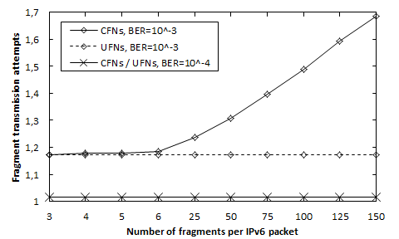
Results (I/III)
n=2 bit
Fragment size (at PHY layer) = 20 bytes

Slide 5
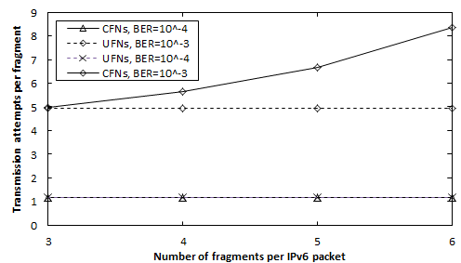
Results (II/III)
n=2 bit
Fragment size (at PHY layer) = 200 bytes

Slide 6
Results (III/III)
n=3 bit
  I.e. resend whole IPv6 packet for bursts of at least X=7 consecutive lost fragments
No performance difference between UFN and CFN for BER=10⁻³
  (…In the conditions considered)
  Very low probability of 7 consecutive lost packets
  CFNs and UFNs perform the same for number of fragments up to 7

Slide 7
Conclusions
No performance degradation for small IPv6 packets
  Small = need up to X fragments to be transported
For n=2, CFNs only degrade performance for very low quality (~BER=10⁻³)
  In that case, performance degradation grows with fragment size and number of fragments per IPv6 packet
For n=3, no performance degradation (for the conditions considered)
  This would be my choice…
Thoughts?

Slide 8
Further considerations
Can we assume reordering will not happen?
  If we can’t, we lose the benefits of CFNs
  Possibly, a question for the WG
Do we agree that
  We want to enable (optional) reliable fragment delivery at LPWAN adaptation layer?
  If yes, do we use
    Selective ACK/NACK after the reception of a packet?
    Loss of ACK/NACK
      RTO for the whole packet at the sender?
      No RTO for the whole packet, rely on upper layer retries (otherwise, packet is lost)

